Slide 1
Telco Churn Prediction: Identifying At-Risk Customers
Danielle Maria Perez Lott, Vahid Mamduhi, Justin Villard
Notes:
Briefly introduce the topic and purpose of the presentation.

Slide 2

Problem Statement
The perennial question of customer retention for telecom companies:
"Which customers are likely to churn?"
Notes:
churn refers to customers canceling their phone, internet, or cable TV subscriptions

Slide 3
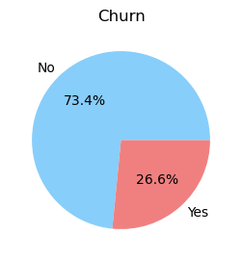
Insights From In-House Data
5,976 customers
19 potential indicators:
Personal Info
gender - client gender (male / female)
SeniorCitizen - is the client retired
Partner - is the client married
Dependents - has the client dependents
Internet
PhoneService - is the telephone service connected
MultipleLines - are multiple phone lines connected
Phone
InternetService - client’s Internet service provider (DSL, Fiber optic, No)
OnlineSecurity - is the online security service connected
OnlineBackup - is the online backup service activated
DeviceProtection - does the client have equipment insurance
TechSupport - is the technical support service connected
Billing and Payment Profile
tenure - how many months a person has been a client of the company
Contract - type of customer contract (Month-to-month, One year, Two year)
PaperlessBilling - whether the client uses paperless billing
PaymentMethod - payment method (Electronic, Mailed, Bank transfer, Credit card)
MonthlyCharges - current monthly payment
TotalCharges - the total amount that the client paid for the services for the entire time
Streaming
StreamingTV - is the streaming TV service connected
StreamingMovies - is the streaming cinema service activated
Notes:
Highlight the importance of customer retention for telecom companies.
The perennial question of customer retention for telecom companies.

Slide 4
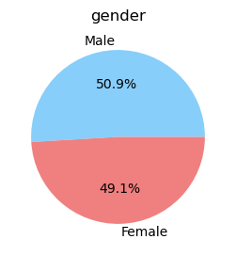
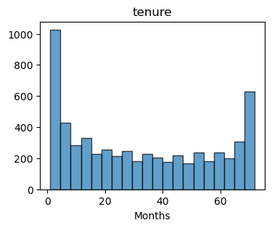
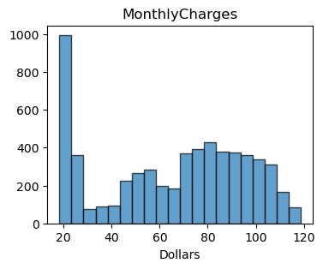
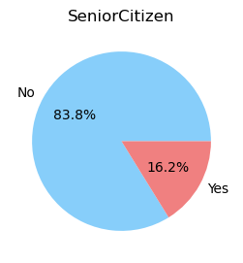
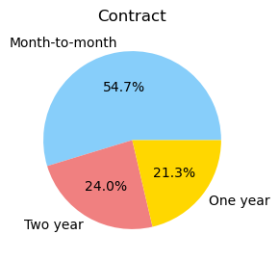
Data Exploration and Preprocessing
Personal Info
Billing and Payment Profile
Binary classification problem (churn, no churn):
  Categorical features: One-Hot Encoding
  Numerical features: Standard Scaling
Notes:
Start with descriptive statistics (e.g., mean, median, count) for numeric features (tenure, MonthlyCharges, TotalCharges).
Display gender distribution and SeniorCitizen percentage.
Visualize categorical features (Partner, PhoneService, InternetService) using bar charts.
Show churn distribution (Churn: Yes/No).

Slide 5
Exploratory Data Analysis (EDA)
Key findings on the churn rate:
Independent of the gender
Higher for senior citizens (42%) than for non-seniors (24%)
Higher for fiber optic service provider (42%) than for DSL (19%)
Higher without technical support (41%) than with (15%)
Higher for Month-to-month contract type (43%) than others (<12%)
Higher for Electronic check payments (45%) than other methods (<20%)
Notes:
Present key EDA findings:
OK Churn rate by contract type (bar chart).
NO MonthlyCharges vs. TotalCharges (scatter plot).
OK Churn rate by payment method (bar chart).
OK Churn rate by gender (bar chart).
Use visualizations to support insights.

Slide 6
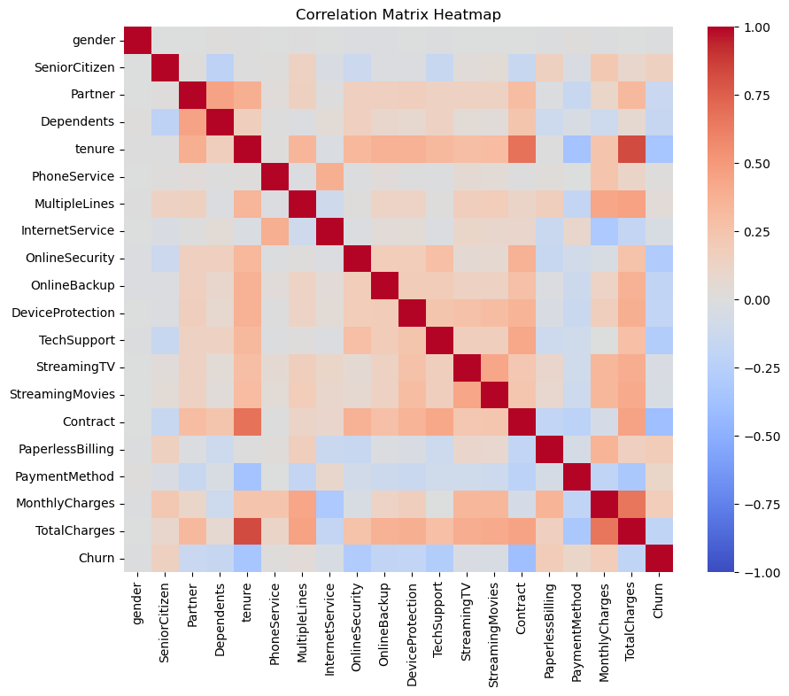
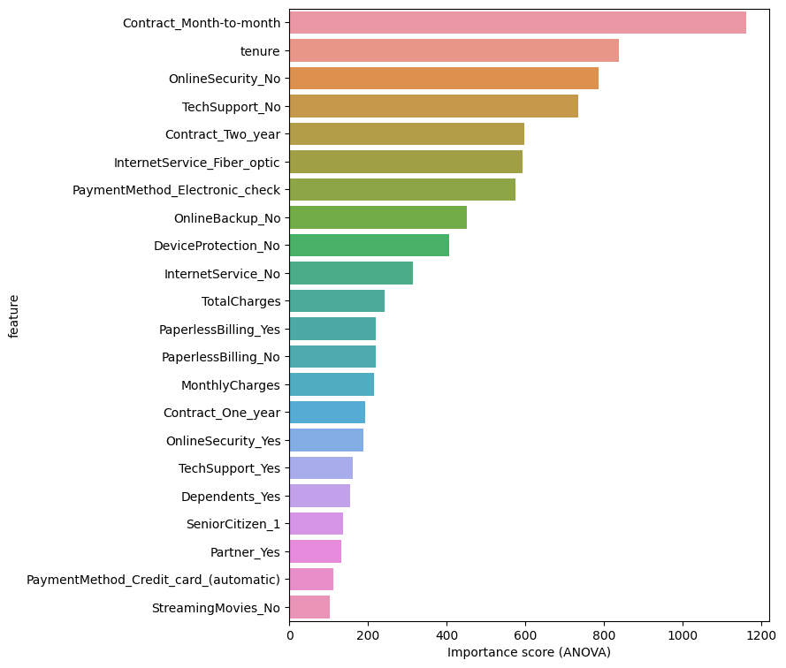
Feature Importance
11 features
20 features
Notes:
Discuss feature selection techniques (e.g., Correlation Matrix, Feature Importance).
Highlight selected features for the model.

Slide 7
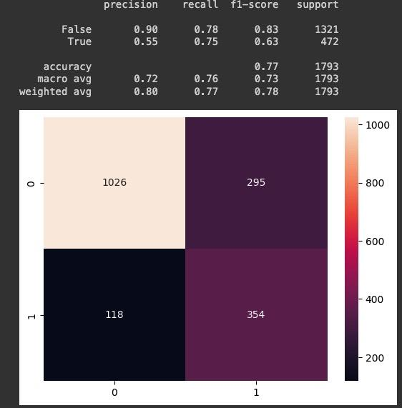
Model Building and Evaluation
Introduce the supervised classification approach.
Mention the selection of algorithms (e.g., Logistic Regression, Decision Trees, Random Forest, XGBoost, Neural Networks, ensemble or stacking).
Present evaluation metrics:
  Confusion Matrix
  Accuracy
  Precision, Recall, F1-Score
  ROC-AUC Curve
We used 3 approaches: PyCaret Model, AutoML Model, and DRF
Best performance in terms of F1-score, and false-positive score: Gradient Boosting Machine (GBM), from the AutoML Model

Slide 8
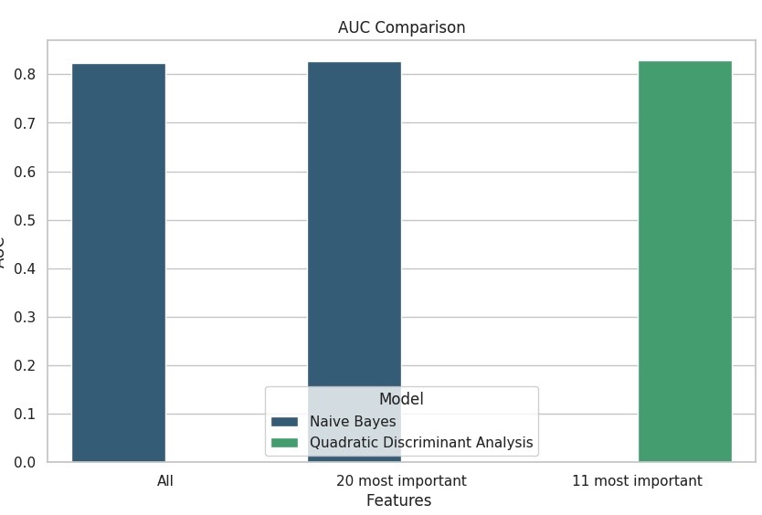
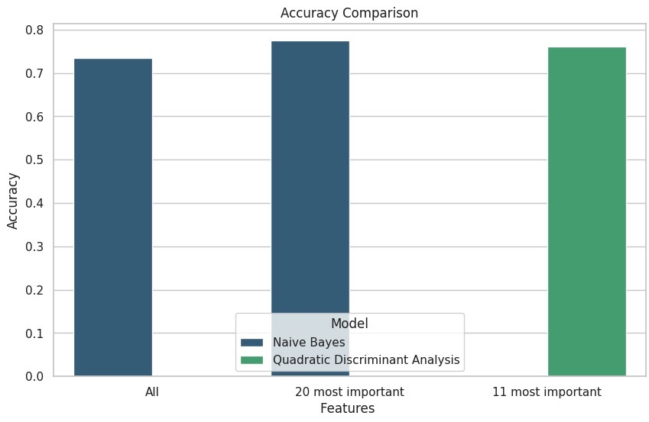
Model Performance & Feature Selection:PyCaret Model

Slide 9
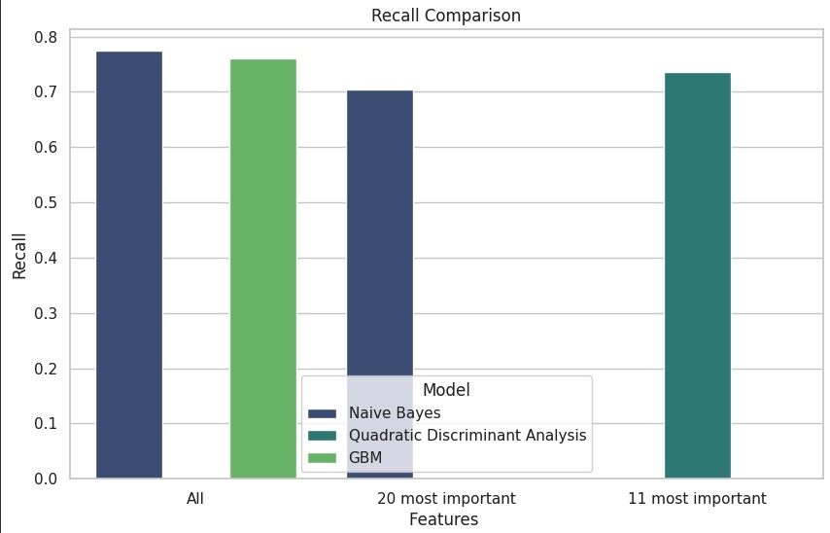
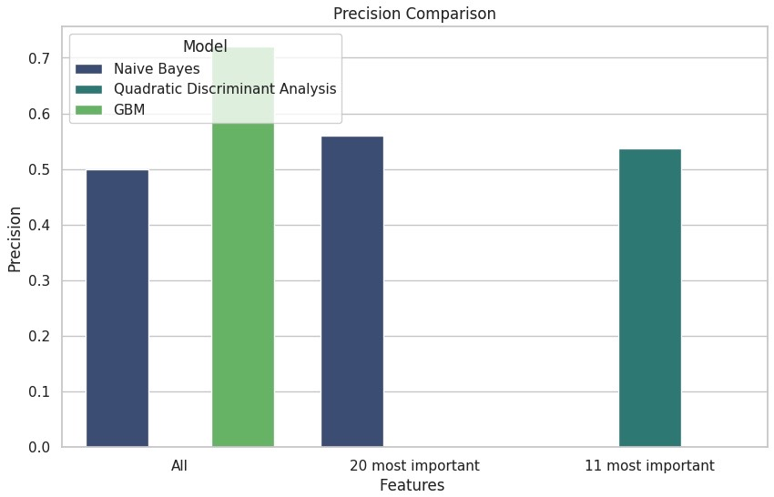
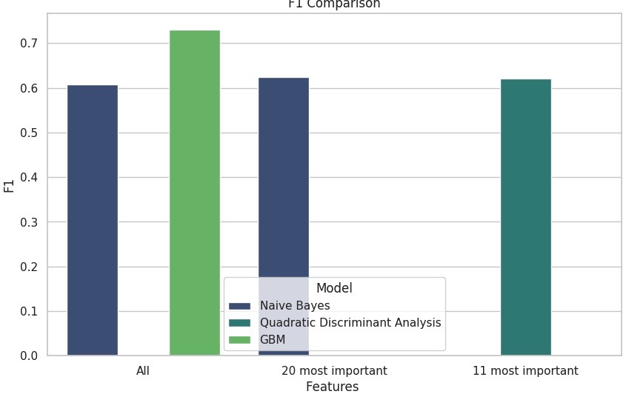
Model Performance & Feature Selection:AutoML Model

Slide 10
Conclusions
Summarize the findings:
  Identified factors influencing churn.
  Performance of the predictive model.
Discuss business implications:
  Recommendations for reducing churn.
  Potential for cost savings.
Mention potential next steps:
  Continuous monitoring of customer churn.
  Fine-tuning the model.
  Implementing targeted retention strategies.

Slide 11
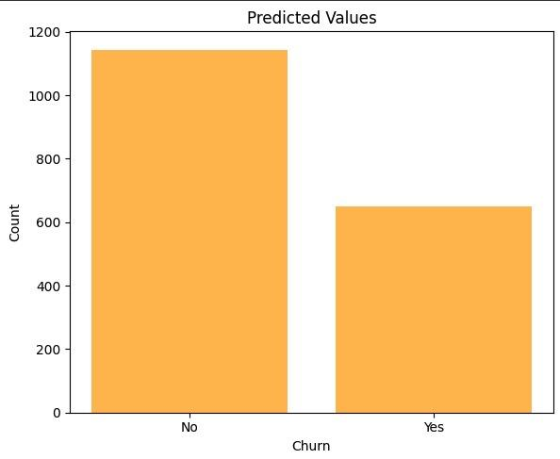
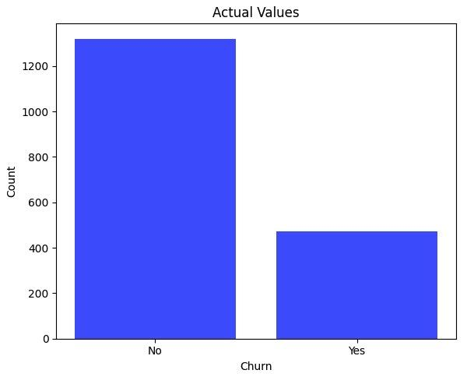
Summarize Findings

Slide 12
Business Implications(Recommendations):
Survey regarding Fiber Optics and Electronic Payment to improve Customer Satisfaction;
Offer more Technical Support within packages;
Attractive package offers (for longer contract periods);
Reward system for Month-to-Month contracts; and
Focus more on attracting non-Senior Customer.

Slide 13
Next Steps:
Continuous monitoring of the customer churn;
Fine-tuning the model, adjusting the hyperparameters for a better performance; and
Implementing and checking the impact of the proposed strategies of customer retention.

Slide 14
Data Preprocessing
Highlight the importance of preprocessing for machine learning.
Discuss data cleaning steps (handling missing values, converting data types).
Encode categorical features (e.g., Label Encoding or One-Hot Encoding).
Feature scaling, numerical features.
Notes:
Highlight the importance of preprocessing for machine learning.
Discuss data cleaning steps (handling missing values, converting data types).
Encode categorical features (e.g., Label Encoding or One-Hot Encoding).
Feature scaling, numerical features.

